Slide 1
Patient condition Classification System Using Machine Learning and NLP
Rahul Mhapankar
Harsh Kocharekar
Bhattu Puneeth Raju
Gattineni Neha
Amit chaudhari
Group No – P642 - group -3

Slide 2
Drug Prediction System Using Machine Learning and NLP
This project develops a machine learning based drug prediction system that analyzes patient reviews and drug names to predict the medical condition being treated.
The system uses Natural Language Processing (NLP) to process textual data and applies multiple machine learning algorithms to classify diseases.
The goal of the project is to demonstrate how AI can analyze medical reviews to support healthcare insights and decision making.

Slide 3
OBJECTIVE
The main objective of this project is to develop a machine learning model that predicts medical conditions based on drug names and patient reviews:
The system aims to:
• Analyze patient drug reviews • Clean and process medical text data using NLP • Extract meaningful features from text • Train machine learning models for prediction • Compare different algorithms • Select the best performing model
The project demonstrates how machine learning can assist in healthcare analytics using real patient review data

Slide 4
DATASET DETAILS
Dataset Used: drugsCom Dataset
The dataset was obtained in Excel (.xlsx) format and contains drug reviews from patients.
Original Dataset Columns
• drugName • condition • review • rating • date • usefulCount
For this project, the following important columns were used:
• drugName – Name of the medicine • condition – Disease being treated • review – Patient review text

Slide 5
Filtered Medical Conditions
To simplify the prediction task, the dataset was filtered to include only three conditions:
• Depression • High Blood Pressure • Type 2 Diabetes
Filtering helps the model:
• Focus on relevant diseases • Improve prediction accuracy • Reduce noise in the dataset
This results in a balanced and meaningful classification problem.

Slide 6
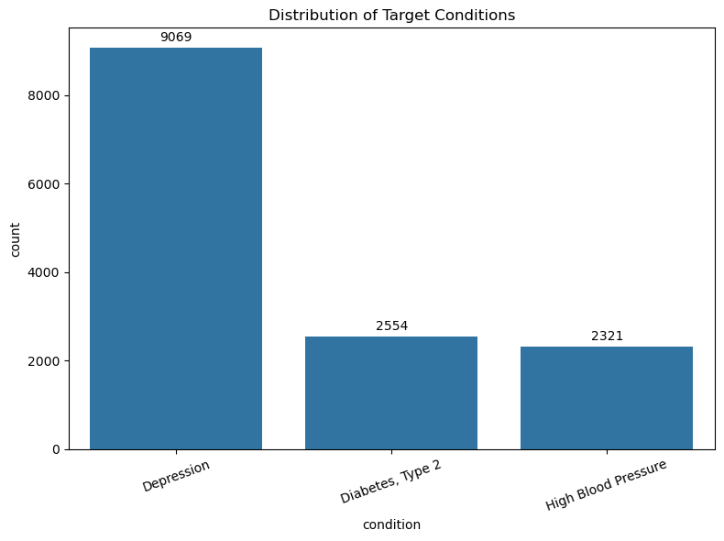
Exploratory Data Analysis (EDA)
EDA was performed to understand the dataset and identify patterns.
Key analysis performed:
• Distribution of medical conditions • Number of reviews per condition • Identification of class imbalance • Basic statistics of text reviews
Visualization techniques such as count plots and histograms were used to understand the dataset.
EDA helps in:
• Understanding dataset structure • Detecting anomalies • Preparing data for machine learning

Slide 7
Handling Missing Data
Real-world healthcare datasets often contain incomplete information.
Steps taken:
• Checked missing values in dataset • Removed rows with missing drugName or review
Code used:
df = df.dropna(subset=['review','drugName'])
Benefits:
• Ensures data quality • Prevents errors during training • Improves model reliability

Slide 8
Text Cleaning (NLP Preprocessing)
Patient reviews contain unstructured text, so preprocessing is required.
The following steps were applied:
• Convert text to lowercase • Remove punctuation and special characters • Remove stop words (common words like “the”, “is”, “and”) • Apply lemmatization to convert words to root form
Example:
"These tablets were helping me a lot"
becomes
"tablet help lot"
This improves feature quality for machine learning models.

Slide 9
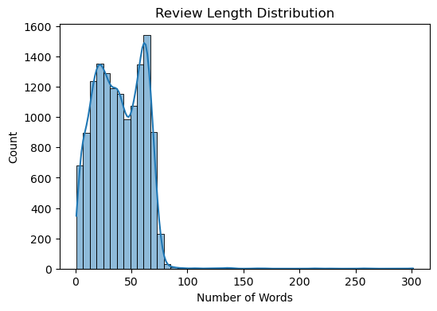
Review Length Analysis
Review length analysis was performed to understand how detailed patient reviews are.
A histogram was created showing:
Number of words per review
Insights gained:
• Most reviews contain short to medium length text • Extremely long reviews are rare • Text length distribution helps understand dataset complexity
This analysis helps determine how much information is available for prediction.

Slide 10
Feature Engineering
Machine learning models cannot process text directly.
Therefore text was converted into numerical features.
Two features were combined:
combined_text = drugName + review
This helps the model understand both:
• Medicine name • Patient experience with the drug
Combining both improves prediction capability.

Slide 11
Label Encoding
The target variable condition is categorical.
Machine learning models require numerical labels.
Therefore Label Encoding was used.
Example conversion:
Depression → 0 High Blood Pressure → 1 Type 2 Diabetes → 2
This allows the model to learn patterns between text and medical condition.

Slide 12
Train Test Split
The dataset was divided into two parts:
Training Data – 80%
Used to train the machine learning models.
Testing Data – 20%
Used to evaluate how well the model performs on unseen data.
Code used:
train_test_split(test_size=0.2, stratify=df['label'])
Stratification ensures that each class is equally represented in both datasets.

Slide 13
TF-IDF Vectorization
Text data was converted into numerical vectors using TF-IDF (Term Frequency – Inverse Document Frequency).
TF-IDF measures how important a word is in a document relative to the entire dataset.
Configuration used:
• Maximum features: 15000 • N-gram range: (1,2) • Minimum document frequency: 2
Advantages:
• Captures important keywords • Reduces importance of very common words • Improves classification performance

Slide 14
Model Building
Three machine learning models were trained and compared.
Logistic Regression
• Simple linear classification model • Works well with high-dimensional data
Multinomial Naive Bayes
• Very effective for text classification • Fast training and prediction
Linear Support Vector Machine (SVM)
• Powerful classifier for text data • Handles high dimensional feature space efficiently
Each model was trained using TF-IDF features.

Slide 15
Accuracy Comparison
After training all models, their accuracy was compared.
Model comparison table:
The Linear Support Vector Machine achieved the best performance, so it was selected as the final model.
Model | Accuracy
Logistic Regression | Moderate - 0.976694
Naive Bayes | Moderate - 0.958049
Linear SVM | Highest - 0.993905

Slide 16
Model Evaluation
The final model was evaluated using:
Accuracy Score
Measures overall correctness.
Classification Report
Includes:
• Precision • Recall • F1-Score
These metrics help evaluate how well the model predicts each medical condition.
 | precision | recall | f1-score | support
Depression | 0.99 | 1.00 | 1.00 | 1814
Diabetes, Type 2 | 1.00 | 0.99 | 0.99 | 511
High Blood Pressure | 0.99 | 0.98 | 0.99 | 464
accuracy |  |  | 0.99 | 2789
macro avg | 0.99 | 0.99 | 0.99 | 2789
weighted avg | 0.99 | 0.99 | 0.99 | 2789

Slide 17
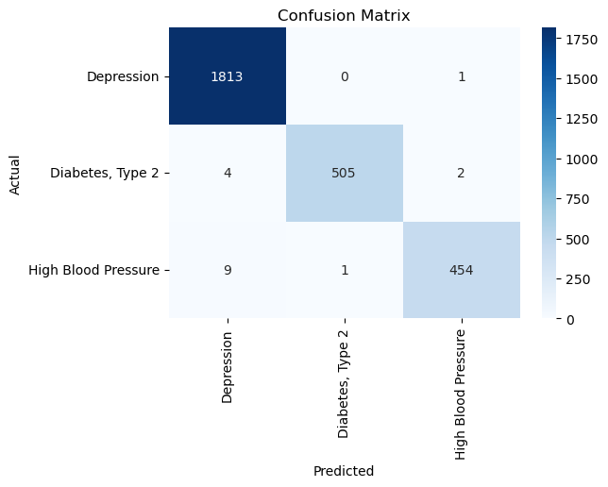
Confusion Matrix
A confusion matrix was generated to analyze prediction performance.
It shows:
• Correct predictions • Misclassifications between diseases
This helps identify:
• Which diseases are easier to predict • Which classes are sometimes confused
Visualization was created using Seaborn heatmap.

Slide 18
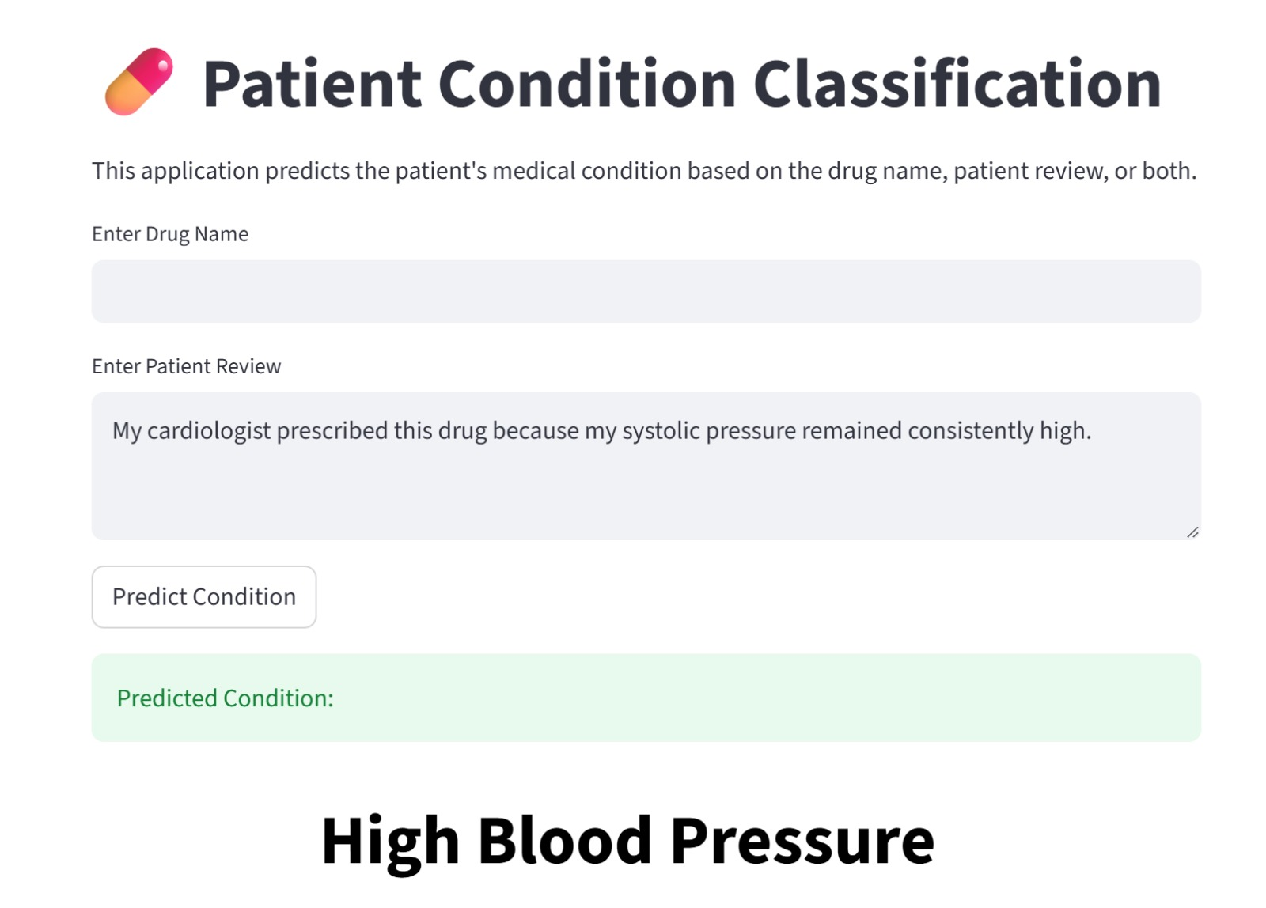
App Page:

Slide 19
Challenges Faced During the Project
Several challenges were encountered during development:
• Handling large amounts of unstructured text data • Cleaning patient reviews containing noisy information • Selecting appropriate NLP preprocessing techniques • Choosing the best machine learning algorithm • Balancing prediction accuracy across diseases
These challenges were addressed through:
• Text preprocessing • Feature engineering • Comparing multiple models

Slide 20
Thank You
We would like to express our sincere gratitude to:
Faculty at Excelr for guidance and continuous support during the project.

